Slide 1
Business Loans:
Done On Time Or Defaulted On?
By: Emerie, Natalia, and Sherry

Slide 2
Data Overview:
Our data is from the US Small Business Administration (SBA)
899,164 rows / 27 columns
Parameters of interest:
Urban vs Rural
New vs Existing
Franchise vs Non Franchise
Disbursement Gross
SBA Approval
Bank Approval
Sectornum
Number of Employees
MIS_Status
Term
State
LowDoc Program

Slide 3
Factors for Loan Amounts

Slide 4
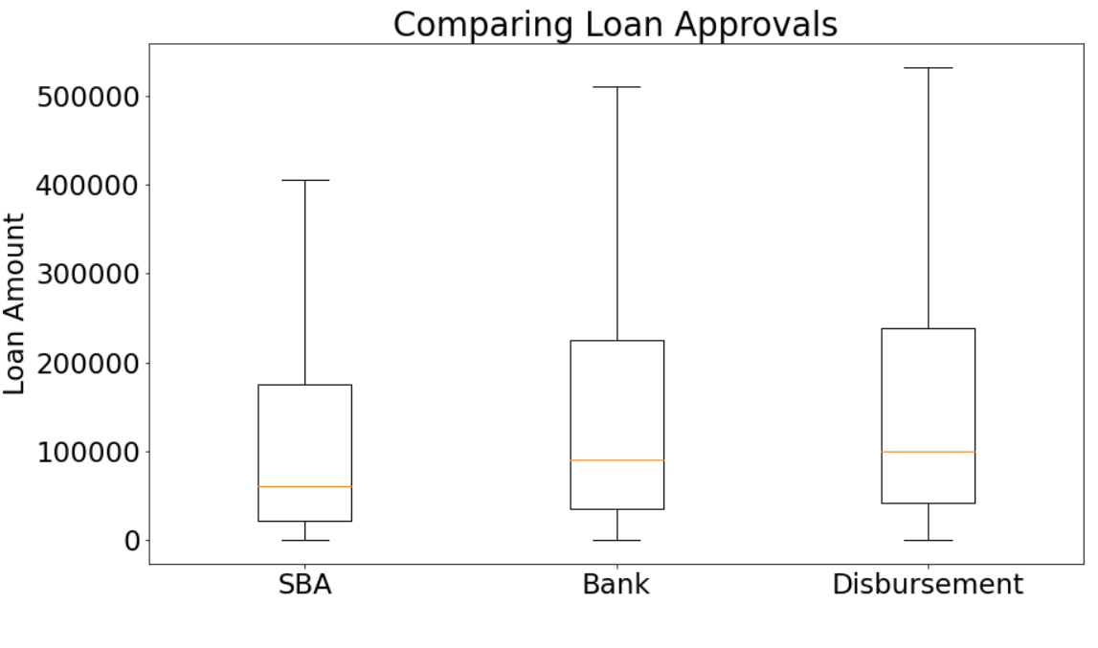
Approved vs Actual Amounts
Actual money disbursed is slightly higher than amounts approved by banks
196 entries were approved but had $0 disbursed - did they back out?

Slide 5
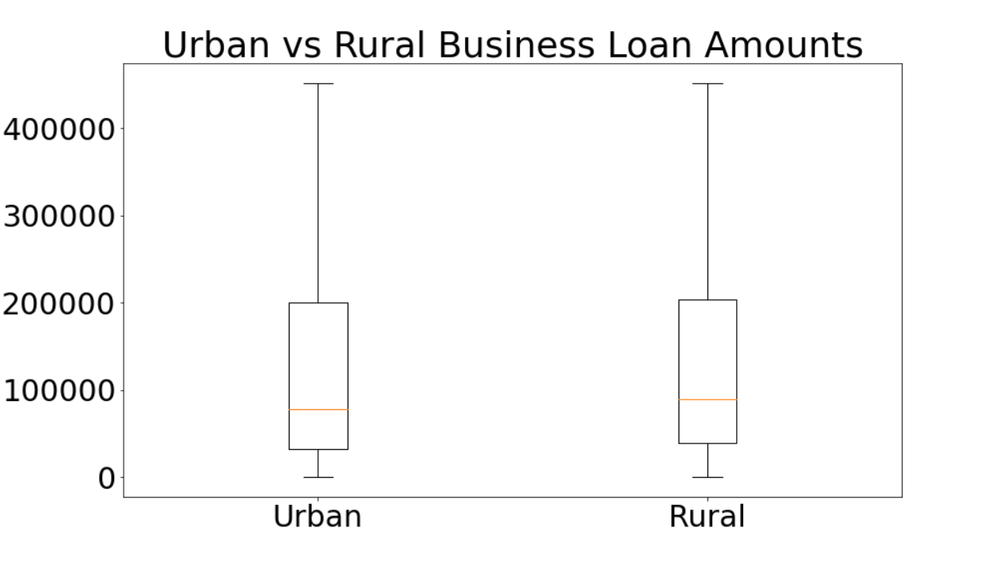
Loan Amounts For Urban and Rural Businesses
Urban and rural businesses take out similar loan amounts

Slide 6
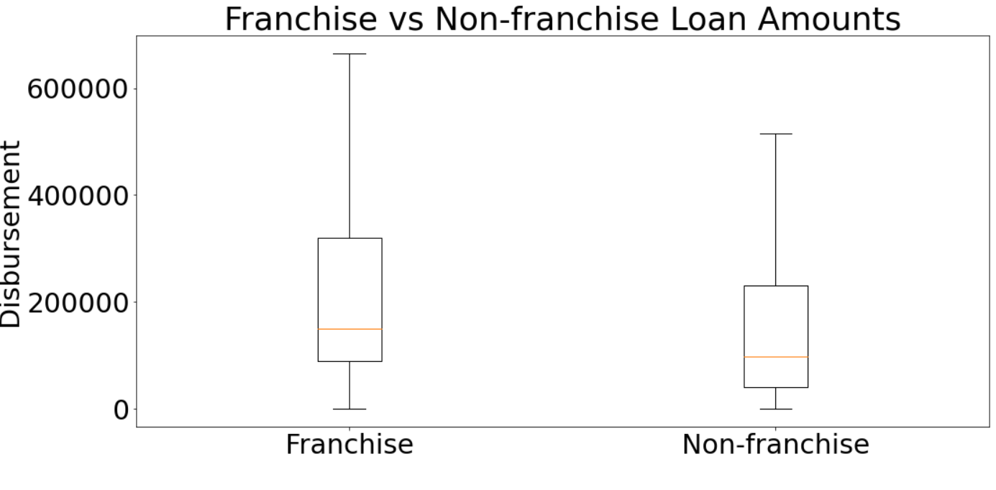
Franchised vs Non-franchised Business Loans
Franchises borrow more money than non-franchises

Slide 7
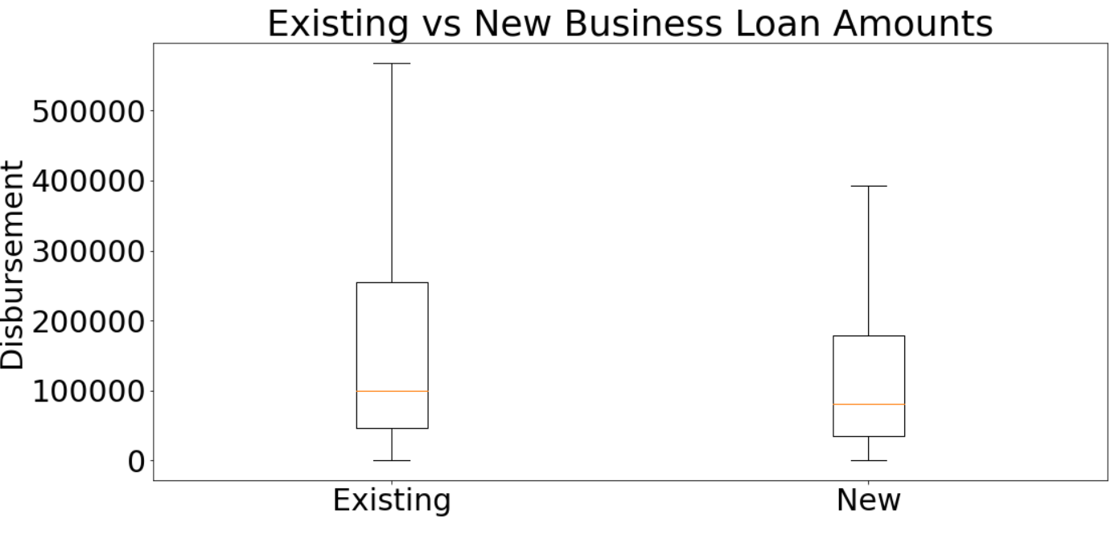
Existing vs New Business Loans
Existing businesses borrow more money than new businesses

Slide 8
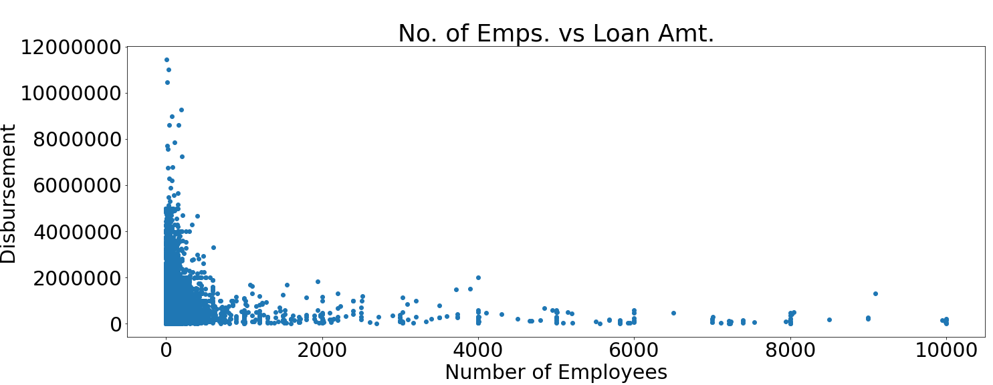
Business Size vs Loan Amount
Most businesses have 20 employees or less, with 6000 entries having “0” employees.
Businesses with more employees did not take out bigger loans.

Slide 9
Predictions of Loan Amounts

Slide 10
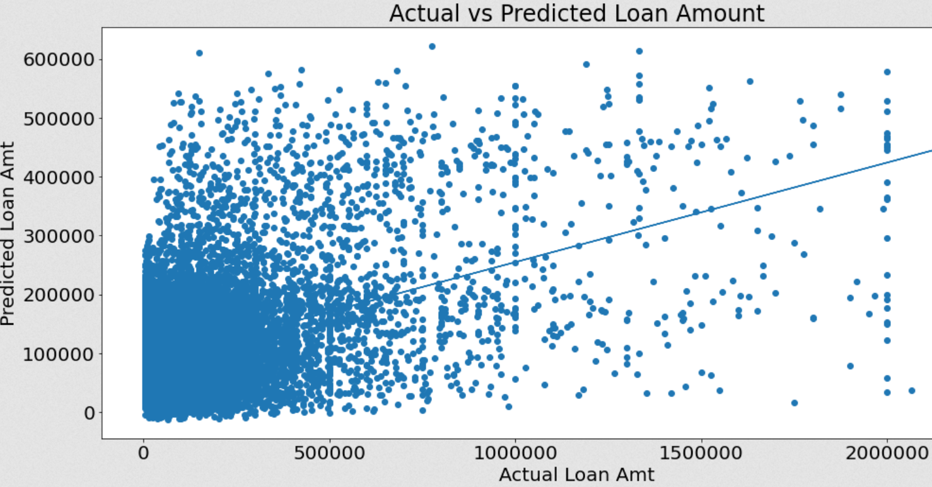
Predicting disbursement with linear regression

Slide 11
Predicting disbursement with linear regression
Variables included in model:
Revolving line of credit
Franchise/non-franchise
Sector description
Term length
R squared value fluctuated due to different training and testing sets being made when rerunning, but varied from .14 - .18
One more thing…

Slide 12
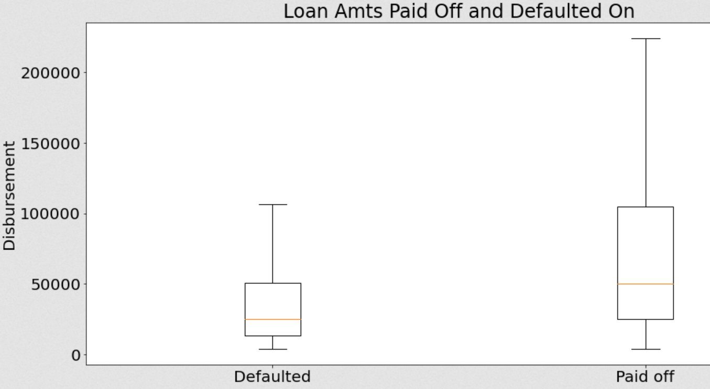
Defaulted vs Paid Off Loan Amounts

Slide 13
Factors for Defaulted Loans

Slide 14
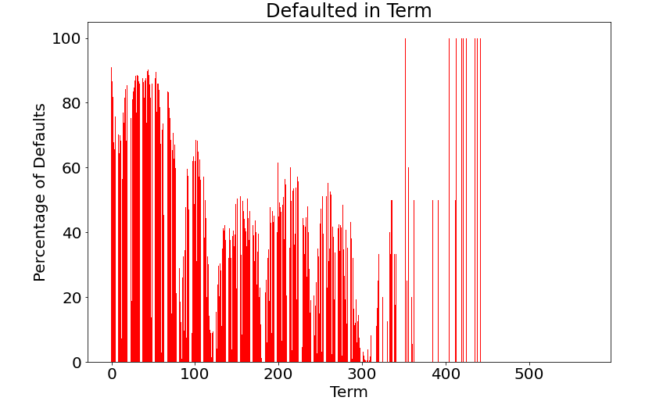
Defaults in Terms (Months)
More defaults are happening with businesses who have shorter terms.
Very few people have terms over 300.

Slide 15
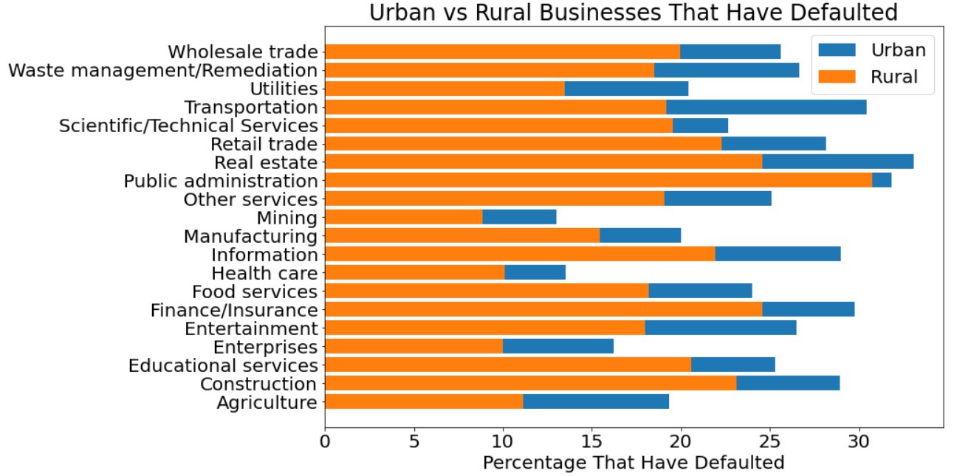
Urban versus Rural Businesses
Urban areas are more likely to default.

Slide 16
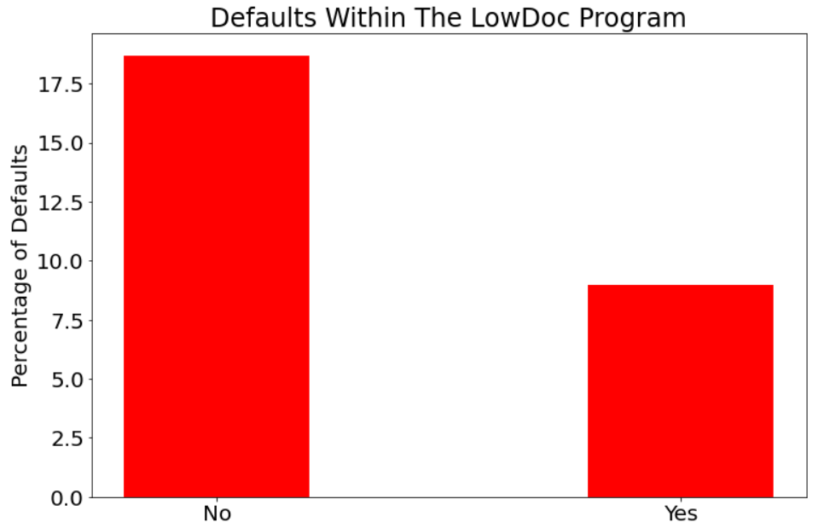
LowDoc Program
The LowDoc Program is a shorter application process for those who get approved.

Slide 17
Predictions of Defaulted Loans

Slide 18
Predicting if Loans will Default
Predicting Default Loans:
accuracy was at 3%:
Logistic Regression was predicting all zeroes
Then accuracy was 96%:
Logistic Regression was predicting all ones
With uneven dataset, decided to train and test with even number of Loans defaulting and not defaulting
Accuracy: 73.32%
ROC AUC: 62.46%

Slide 19
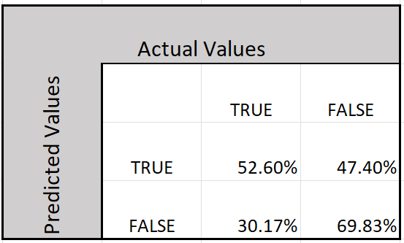
Predicting if Loans will Default
Confusion Matrix:

Slide 20
Main Takeaways:
Franchised and existing businesses are being approved for higher loans.
Urban and rural businesses took out similar amounts.
Having a shorter term for a business loan will most likely result into defaults.
Urban areas are more likely to default.
With this data set, we can predict if a loan will default 70-75% of the time
We are more likely to correctly predict a loan will not default compared to if a loan will default

Slide 21
Thank You!

Slide 22
Extra Slides

Slide 23
Predicting Default Loans
r2 = -31.226352079481345
mse = 0.303359407965205
precision = 0.1645053
recall = 0.52595628
Auroc Score = 0.6246172878417028

Slide 24
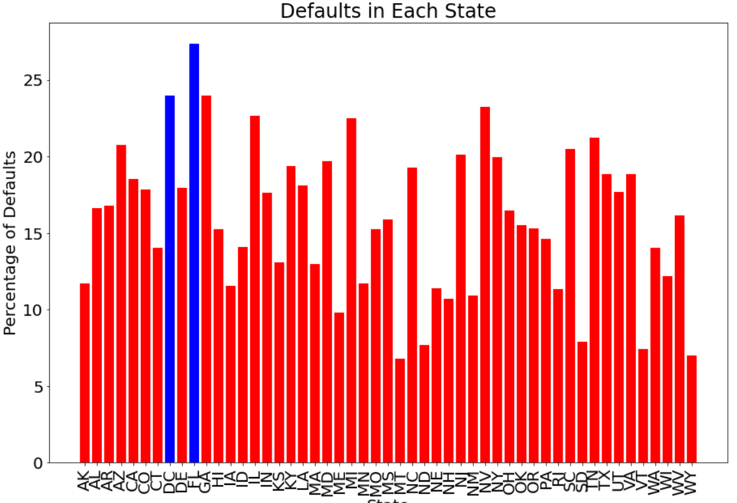
Percentage of Defaults Within Each State
Florida is a highly populated state. Whereas DC isn’t a state, but a district.
The top two defaulted states are opposite in population showing that defaults are not correlated to population.

Slide 25
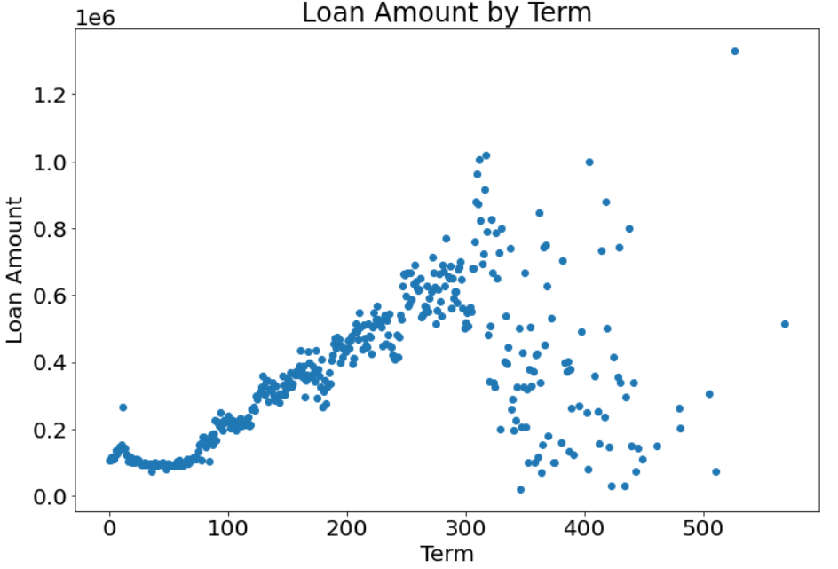
Term Loan Amounts
Comparing the loan amounts by term you can see that it follows a trend until it hits 300 months.
For smaller loan amount businesses will still choose long terms.

